Slide 1
Lecture 2
Chapter-01
Discrete-Event System Simulation
-Jerry Banks
System, model & simulation
1

Slide 2
Systems and System Environment
System
  defined as a group of objects that are joined together in some regular interaction or interdependence toward the accomplishment of some purpose.
System Environment
  changes occurring outside the system.
The decision on the boundary between the system and its environment may depend on the purpose of the study.

Slide 3
Components of a System (1)
Entity : an object of interest in the system.
Attribute : a property of an entity.
Activity : a time period of specified length.
State : the collection of variables necessary to describe the
system at any time, relative to the objectives of the
study.
Event : an momentary occurrence that may change the
state of the system.
Endogenous : to describe activities and events occurring
within a system (Internal).
Exogenous : to describe activities and events in an
environment that affect the system (External).

Slide 4
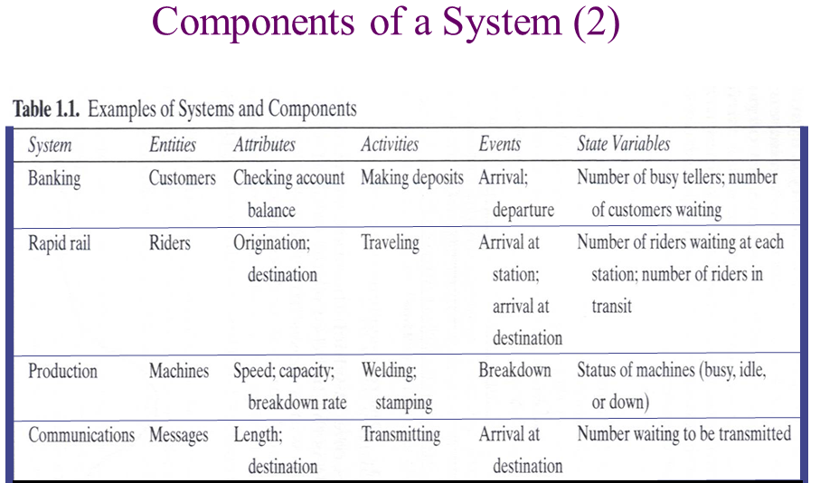
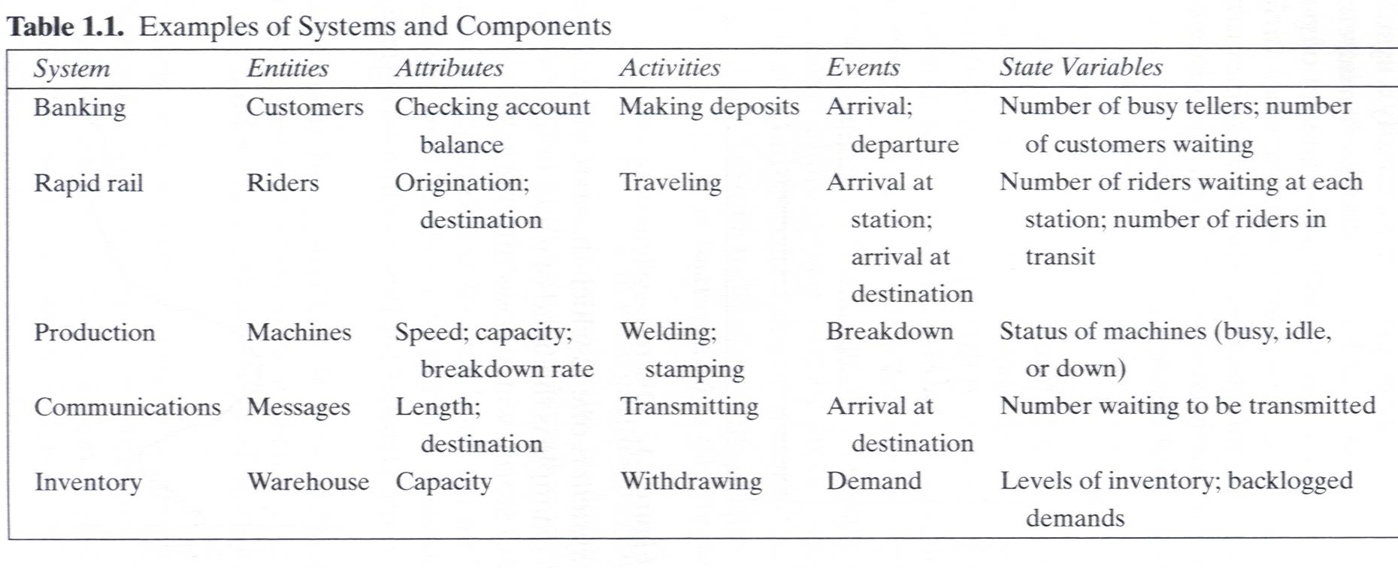
Components of a System (2)

Slide 5
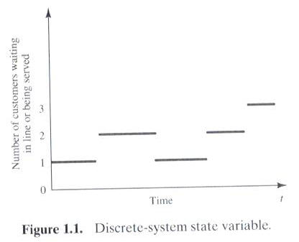
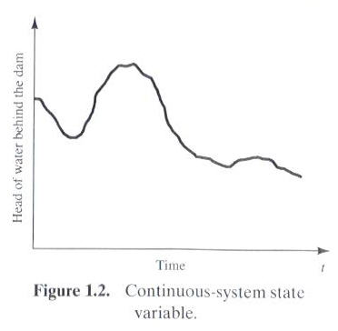
Discrete and Continuous Systems
Systems can be categorized as discrete or continuous.
  Bank : a discrete system
  The head of water behind a dam : a continuous system

Slide 6
Model of a System
Model
  a representation of a system for the purpose of studying the system
  a simplification of the system
  sufficiently detailed to permit valid conclusions to be drawn about the real system

Slide 7
Types of Models
Static or Dynamic Simulation Models
  Static simulation model (called Monte Carlo simulation) represents a system at a particular point in time.
  Dynamic simulation model represents systems as they change over time.
Deterministic or Stochastic Simulation Models
  Deterministic simulation models contain no random variables and have a known set of inputs which will result in a unique set of outputs.
  Stochastic simulation model has one or more random variables as inputs. Random inputs lead to random outputs.
The model of interest in this class is discrete, dynamic, and stochastic.

Slide 8
Discrete-Event System Simulation
The simulation models are analyzed by numerical rather than by analytical methods.
  Analytical methods employ the deductive reasoning of mathematics to solve the model.
  Numerical methods employ computational procedures to solve mathematical models.

Slide 9
Let us see a flow chart, which will describe the steps followed in a simulation study.
(in the next slide)

Slide 10
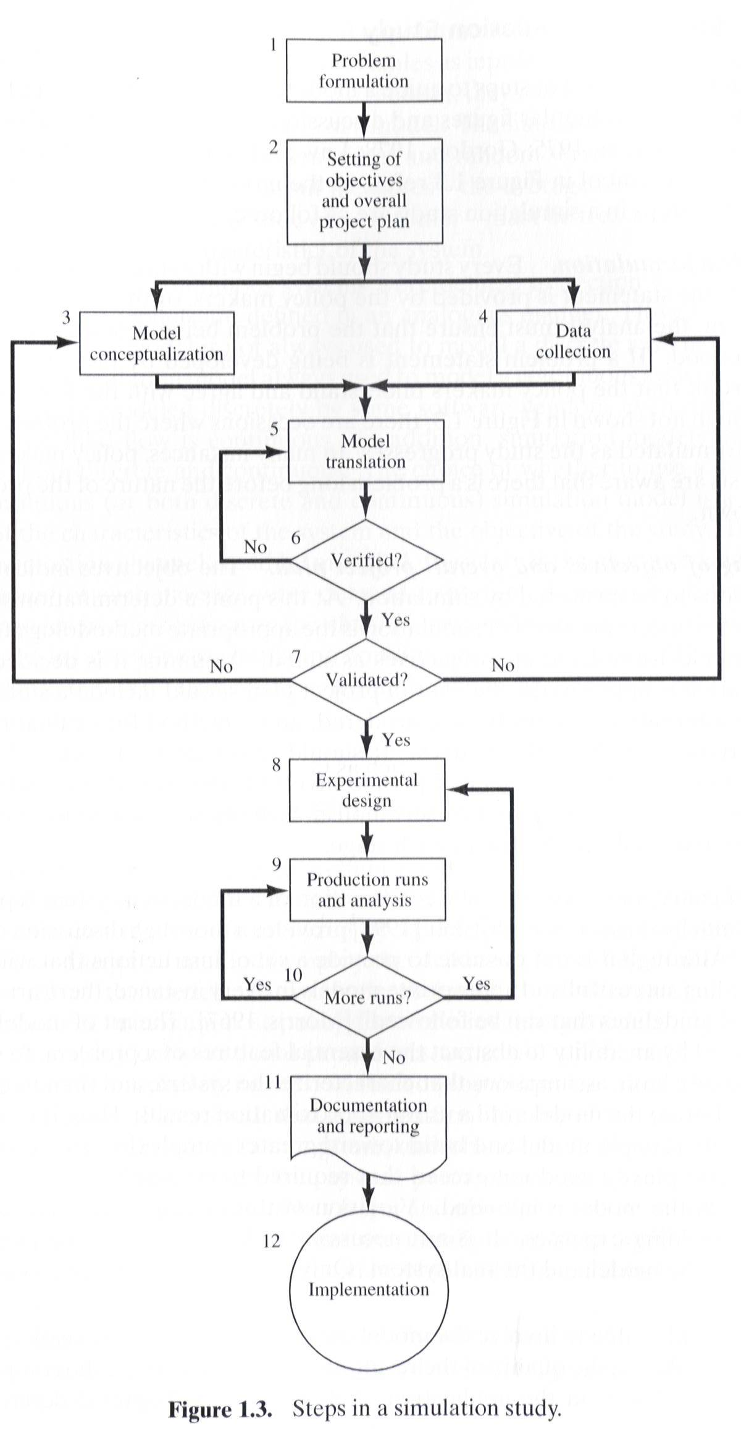

Slide 11
Steps in a Simulation Study (1)
Problem formulation
  Policy maker/Analyst understand and agree with the formulation.
Setting of objectives and overall project plan
Model conceptualization
  The art of modeling is enhanced by an ability to abstract the essential features of a problem, to select and modify basic assumptions that characterize the system, and then to enrich and elaborate the model until a useful approximation results.
Data collection
  As the complexity of the model changes, the required data elements may also change.
Model translation
  GPSS/HTM or special-purpose simulation software

Slide 12
Steps in a Simulation Study (2)
Verified?
  Is the computer program performing properly?
  Debugging for correct input parameters and logical structure
Validated?
  The determination that a model is an accurate representation of the real system.
  Validation is achieved through the calibration of the model
Experimental design
  The decision on the length of the initialization period, the length of simulation runs, and the number of replications to be made of each run.
Production runs and analysis
  To estimate measures of performances

Slide 13
Steps in a Simulation Study (3)
More runs?
Documentation and reporting
  Program documentation : for the relationships between input parameters and output measures of performance, and for a modification.
  Progress documentation : the history of a simulation, a chronology of work done and decision made.
Implementation

Slide 14
Steps in a Simulation Study (4)
Four phases according to Figure 1.3
  First phase : a period of discovery or orientation
  (step 1, step2)
  Second phase : a model building and data collection
  (step 3, step 4, step 5, step 6, step 7)
  Third phase : running the model
  (step 8, step 9, step 10)
  Fourth phase : an implementation
  (step 11, step 12)

Slide 15
The End

